Slide 1
RUNGTA COLLEGE OF DENTAL SCIENCES AND RESEARCH
DIABETES MELLITUS
DEPARTMENT OF GENERAL MEDICINE

Slide 2
SPECIFIC LEARNING OBJECTIVES
MUST KNOW | NICE TO KNOW | DESIRE TO KNOW
INTRODUCTION | DIAGNOSIS | ENDOCRINE PANCREAS
CLASSIFICATION | TYPES | MODY
MANAGEMENT | PATHOGENESIS
COMPLICATIONS

Slide 3
CONTENTS
Endocrine pancreas
Introduction
Diagnosis
Classification
Management
Type 1 DM
Type 2 DM
DM other forms
MODY
Pathogenesis
Complications
Summary

Slide 9
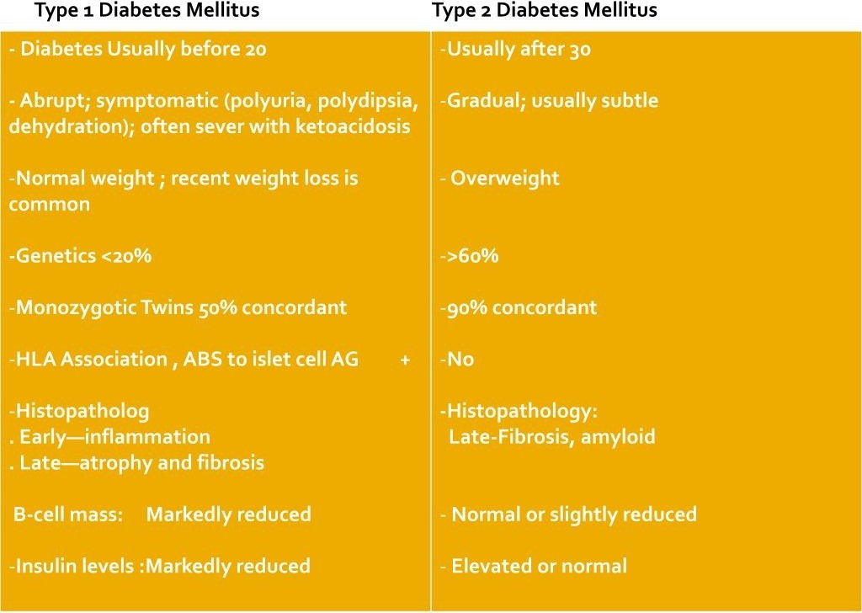

Slide 17
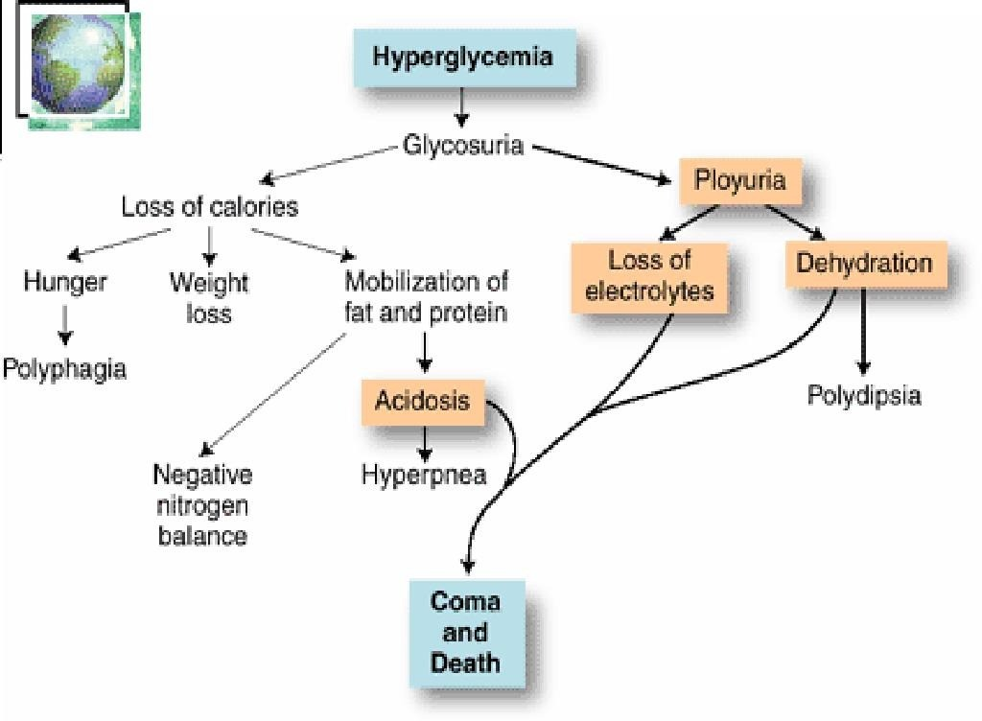

Slide 23
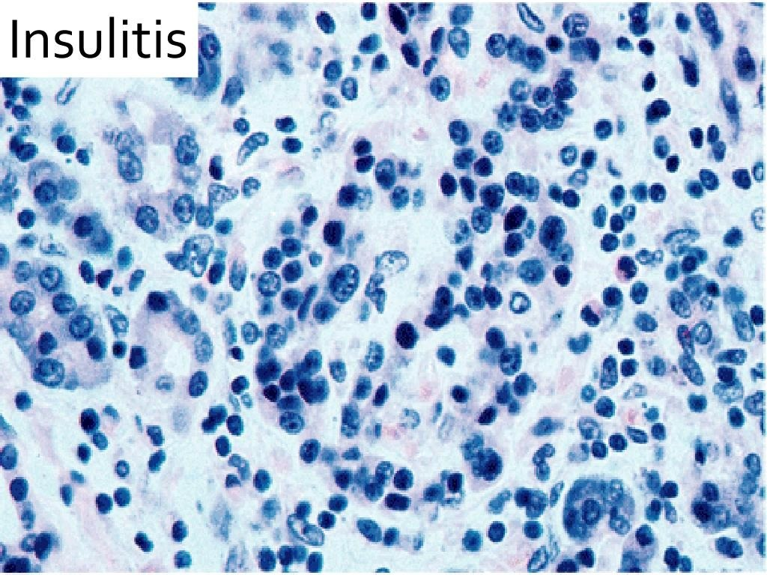

Slide 28
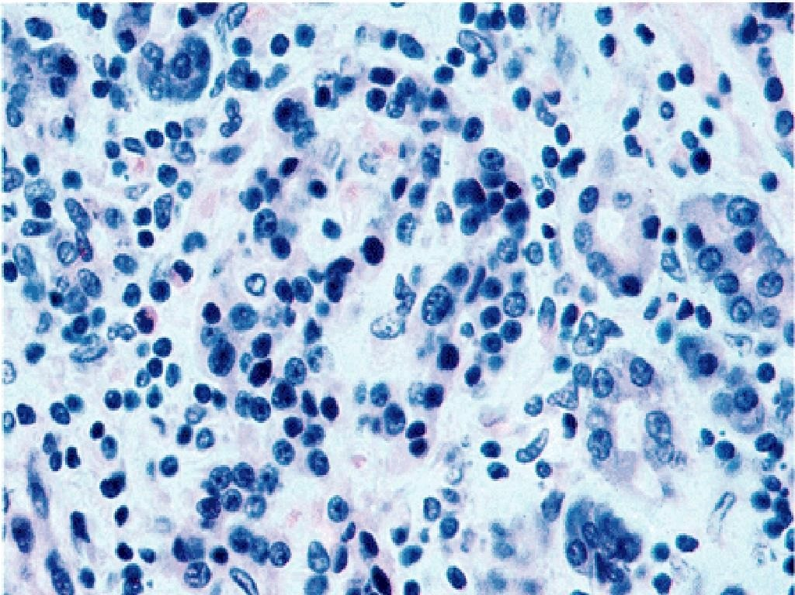

Slide 36
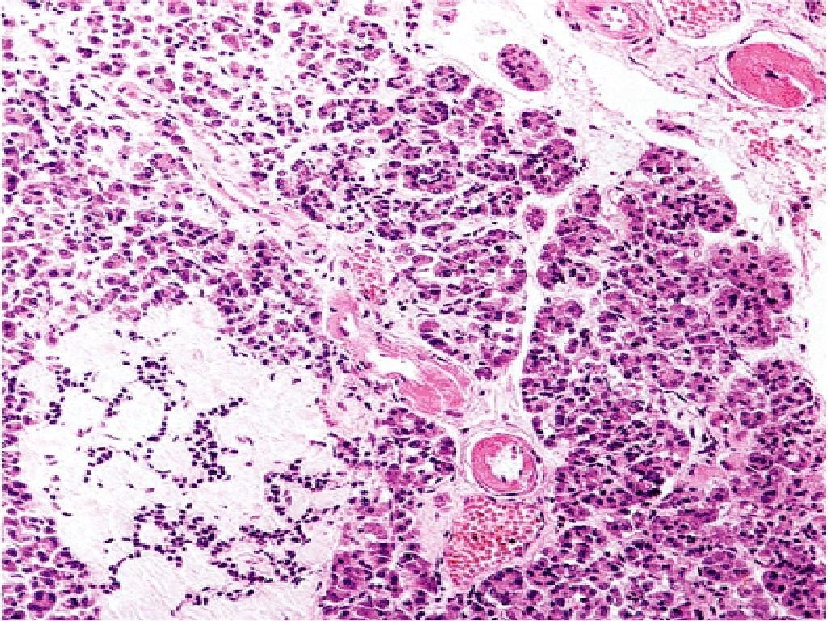

Slide 39
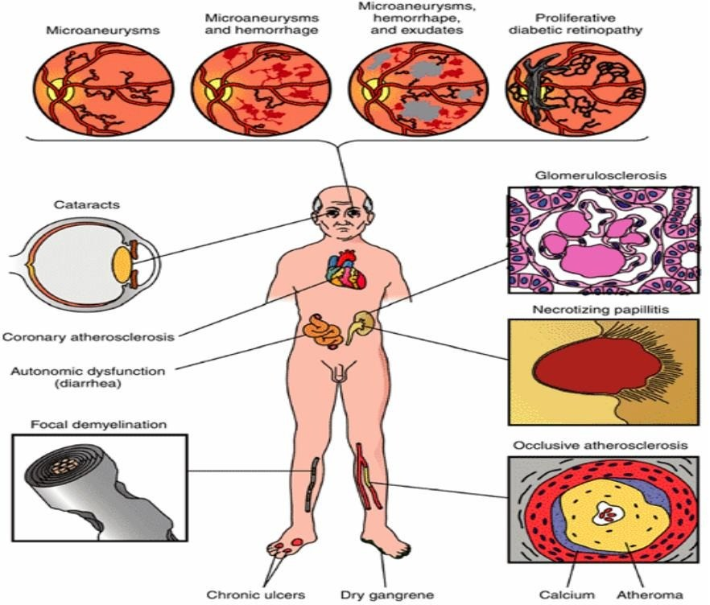

Slide 40
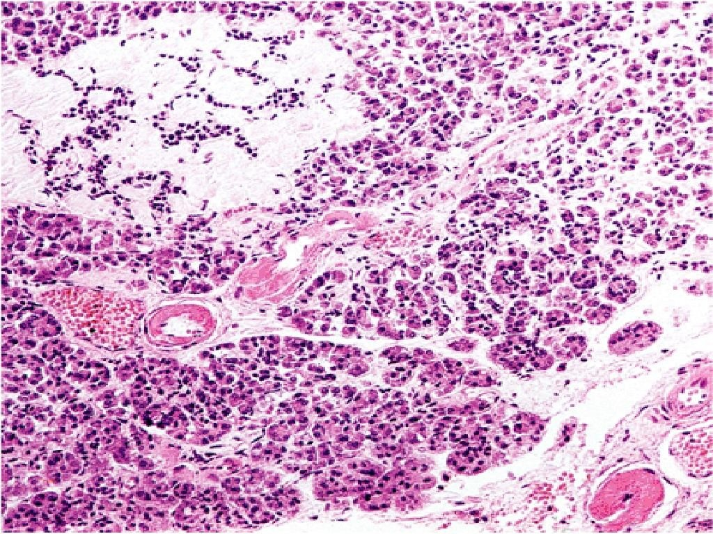

Slide 42
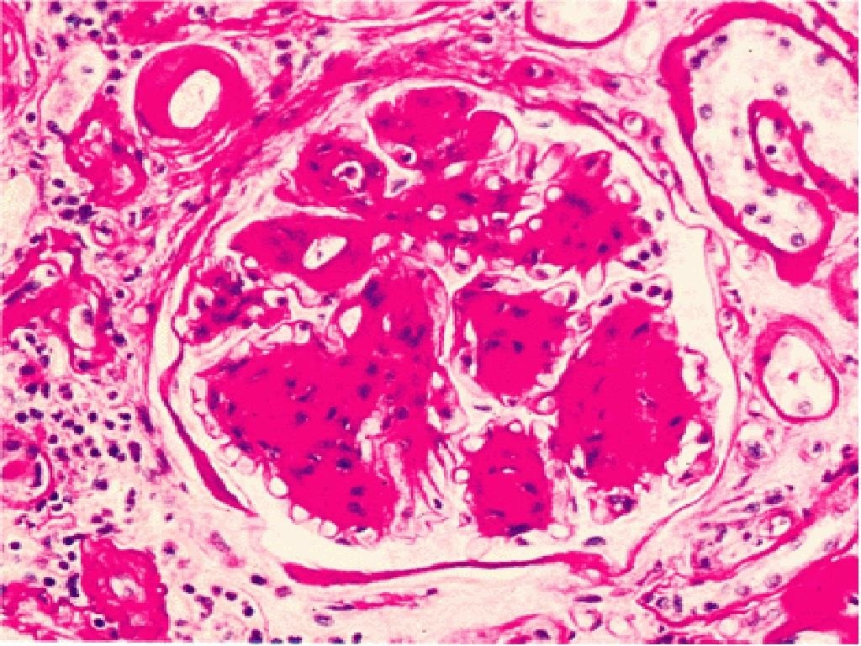

Slide 49
REFERENCES
DAVIDSON’S PRINCIPLES AND PRACTICE OF MEDICINE; 23rd edition
HARRISON’S PRINCIPLE OF INTERNAL MEDICINE; 21ST edition
TEXTBOOK OF CLINICAL MEDICINE by S.N Chugh ;5th edition

Slide 50
QUESTION AND ANSWERS

Slide 51
THANK YOU....

